Slide 1

PHISHING SITE EVALUATION AND DETECTION
Lavanyaa Murali
Jeevana sravya gundapu

Slide 2
CONTENTS
Abstract
Modules Description
Output
Conclusion
Machine Learning Models

Slide 3
Abstract
Our research involves analyzing and identifying phishing websites depending on the URL of the website. Two datasets from Mendely Data for phishing websites, each with 89,000 and 59,000 rows, are included in this research. When performing the URL-based analysis, numerous elements are taken into account for analysis, including the number of redirects, the response time for a domain query, etc. With the use of our technology, one may quickly determine whether a website is a phishing website or not by simply inputting the URL of that website. These are some of this project's benefits:
Finding intriguing patterns in the data that is accessible.
It is discovered which factors are crucial in determining whether a website is a phishing website.
A model is created to determine whether the URL leads to a phishing website or not.
Phishing is a deceptive technique where an attacker tries to trick the victim into giving over personal information. These attacks typically take place through emails, texts, or websites. Nowadays, there is a noticeable increase in phishing websites, which look just like official websites. However, their backend is geared toward gathering private data that the victim enters. Recently, the machine learning community has become interested in finding and identifying phishing websites. As a result, they have developed models and carried out classifications of phishing websites.
A research project

Slide 4
MODULES Description

Slide 5
Data collection: This research uses two datasets, each with 89,000 rows, from Mendely Data for phishing websites. The URL-based analysis is conducted, and numerous elements like the number of redirects, the response time for a domain query, etc. are taken into account for analysis.
The research done to help with the completion of a project is represented by a literature survey in a project report. A literature review also refers to a review of the previously published materials on a report's topic. Analyzing exploratory data: If the user's mobile device contains a heartbeat sensor, it is also possible to see the user's heartbeat.
Data scientists utilize exploratory data analysis (EDA) to evaluate, research, and summarize various data sets. They frequently use data visualization techniques in this process. It can also assist in determining the suitability of the statistical methods you are considering using for data analysis.

Slide 6
Data preprocessing is a data mining technique used to turn raw data into a format that is effective and usable. It entails dealing with incorrect data, noisy data, etc., A file that has been trained to recognize particular patterns is referred to as a machine learning model.
A model is trained using a set of data and an algorithm that allows it to analyze and learn from the data. This project uses a classification model because categorical values are present. On the dataset, number of classification models have been attempted and tested. Model fitness evaluation metrics include recall precision scores, f1 scores, a confusion matrix, and accuracy scores.

Slide 7
MACHINE LEARNING MODELS
We trained the dataset to a variety of machine learning algorithms namely:
KNN Classifier
Logistic regression
Decision tree Classifier
Random forest
Multilayer perceptron
Gradient boost
Adaboost

Slide 8
OUTPUT GRAPHS

Slide 9
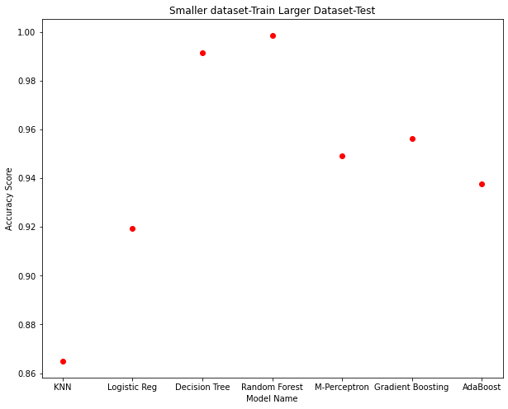

Slide 10
Conclusion
After each algorithm, precision and recall scores will be computed along with accuracies.
Thus, from our research, we have determined that the Random Forest method has produced a greater accuracy value than the other algorithms we used.

Slide 11

THANK YOU

